Slide 1


InTERNSHIP PROJECT PRESENTATION

Slide 2
CONTENTS 1.INtroductiOn 2.LITERATURE REVIEW 3.METHODOLOGY 4.RESULTS 5.CONCLUSION

Slide 3
1.INTRODUCTION
WEB DEVELOPMENT refers to the building, creating, and maintaining of websites. It includes aspects such as web design, web publishing, web programming, and database management. It is the creation of an application that works over the internet i.e. websites.
TYPES OF WEB DEVELOPMENT:
*FRONT END WEB DEVELOPMENT
*BACK-END WEB DEVELOPMENT
*FULL STACK WEB DEVELOPMENT

Slide 4
2. LITERATURE REVIEW
The technologies used in this project are :
HTML : HTML is an acronym which stands for Hyper Text Markup Language which is used for creating web pages and web applications. Hypertext defines the link between the web pages and markup language defines the text document within the tag that define the structure of web pages
CSS : CSS stands for Cascading Style Sheets. It is a style sheet language which is used to describe the look and formatting of a document written in markup language. It provides an additional feature to HTML.

Slide 5
3. JAVASCRIPT : JavaScript (js) is a light-weight object-oriented programming language which is used by several websites for scripting the webpages. It is an interpreted, fullfledged programming language that enables dynamic interactivity on websites when applied to an HTML document.

Slide 6
3. METHODOLOGY
In my project I had used the “code your own”website method to complete the project. Project assigned to me by the BOLT-IOT was to build an interactive and Responisve, Inventrom Website, as part of this project, I had to design a single page User Interface for the Inventrom website using HTML, CSS and JavaScript. This site should have the following 6 components: 1. Navigation Bar 2. Background image with Text section 3. About US section 4. Awards section 5. Contact 6. Footer

Slide 7
4. RESULTS

Slide 11
5. CONCLUSION
Thus the objectives presented during the internship period were successfully completed within the stipulated time. A proper documentation of the development procedure was recorded, which included details about the source code, use-cases and areas that would require extended monitoring and maintenance

Slide 12

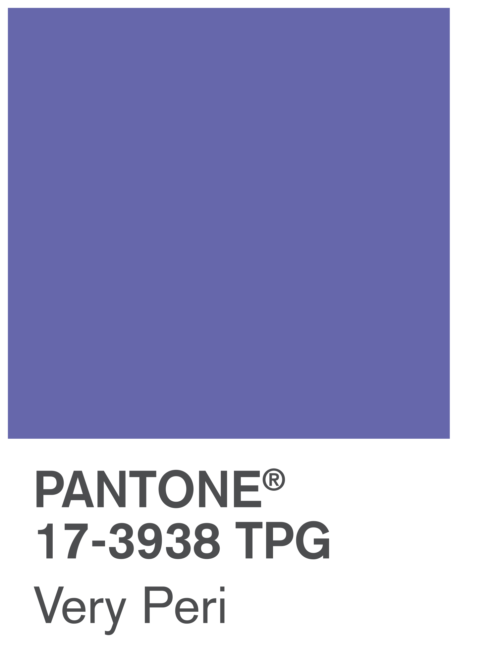
VERY PERI
Introducing the Pantone Color of the Year 2022. PANTONE 17-3938 Very Peri is a dynamic hue that blends the faithfulness and constancy of blue with the energy and excitement of red.
The four color palettes in this template feature Very Peri to help you express your ideas and convey the right mood. Read on to learn how to use these colors in any presentation.

Slide 13
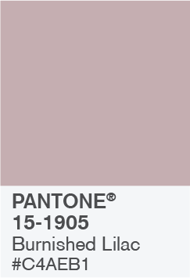
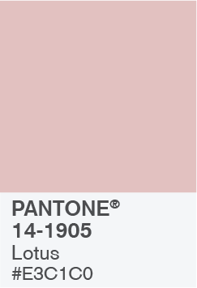
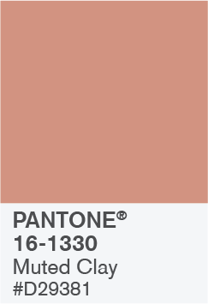

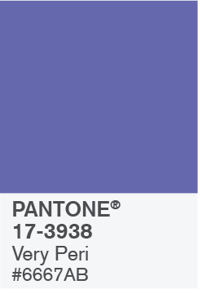

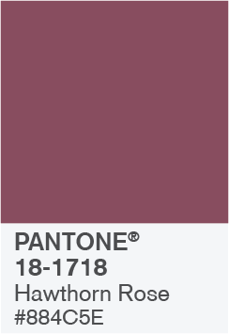
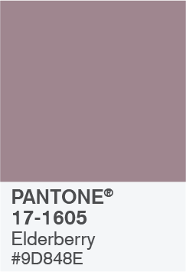
BALANCING ACT

Slide 14
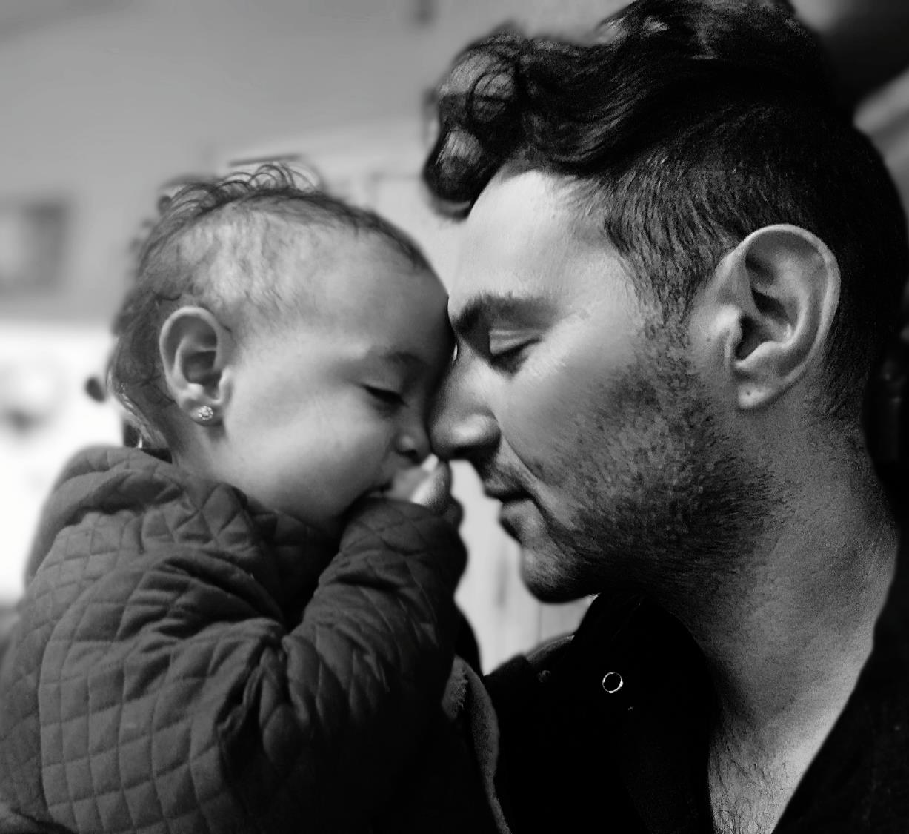
BALANCING ACT
Use this color palette when you want a balance between warm and cool. PANTONE Very Peri is intensified within this artfully calibrated palette, injecting a feeling of liveliness and visual vibration.

Slide 15



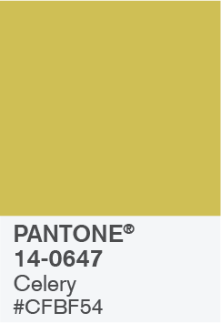
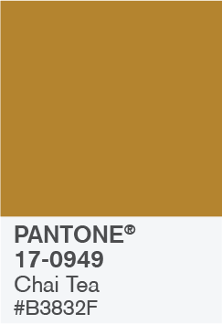


WELLSPRING

Slide 16

WELLSPRING
Use this color palette when you want a blend of nature-infused hues that highlight the compatibility of the greens and the “health giving” properties of these deliciously subtle and nourishing hues.

Slide 17
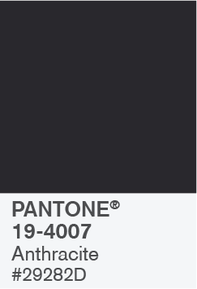

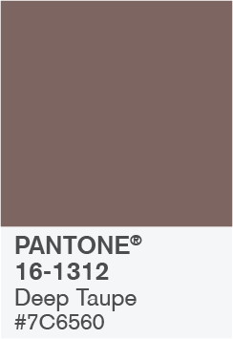

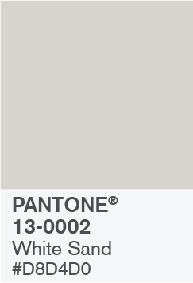

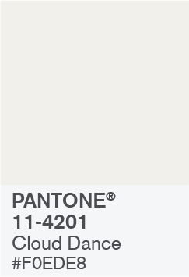
THE STAR OF THE SHOW

Slide 18

THE STAR OF THE SHOW
When you want a more elegant approach, the dynamic presence of PANTONE Very Peri shines as the star of the show in this palette of classics and neutrals whose understated stylishness conveys a message of timeless sophistication.

Slide 19
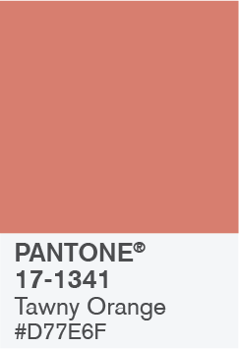
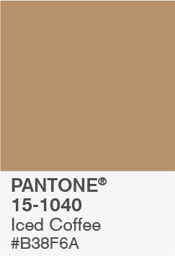
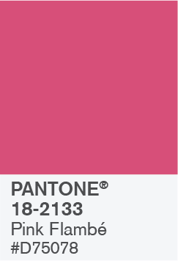
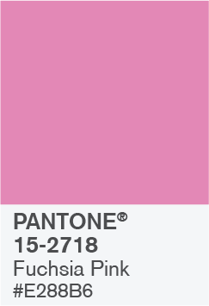
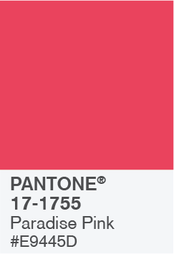


AMUSEMENTS

Slide 20

AMUSEMENTS
Use this color palette when you want to tell a joyous and whimsical story. In this palette, PANTONE Very Peri injects a sense of playful freshness into the design, exuding a good-natured warmth that quickly engages the eye.

